Slide 1
Applied Machine Learning
Clustering – II
K-medoids
Lecture No. 20
Kashif Zafar
April 19, 2025
National University of Computer and Emerging Sciences, Lahore

Slide 2
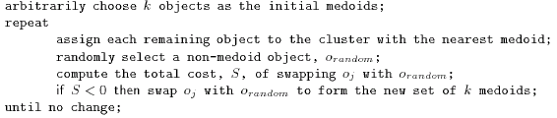
CLUSTER ANALYSIS
Partitioning Methods: k-medoids
Instead of mean we nominate a median of the cluster
This makes it less sensitive to outliers
It is computationally expensive
Notes:
For odd numbers:
X = 1, 3, 4, 6. 9
Y = 5, 8, 9, 10, 12
Median = (4, 9)
For even numbers:
X = 2, 4, 5, 7, 9, 10
Y = 3, 4, 6, 7, 12, 14
Mediod
X = (5+7)/2=
Y = (6+7)/2 =

Slide 3
How to find Mediods:
For odd sum:
[(1, 5), (3, 8), (4, 9), (6, 10), (9, 12)]
X = 1, 3, 4, 6. 9
Sum is 5 (odd)
Y = 5, 8, 9, 10, 12
Mediods = Median of each attribute = (4, 9)
For even sum:
X = 2, 4, 5, 7, 9, 10
Y = 3, 4, 6, 8, 12, 14
Sum = 6 (even)
Mediods = mean of center two elements = (6, 7)
X = (5+7)/2 = 6
Y = (6+8)/2 = 7

Slide 4

CLUSTER ANALYSIS
Partitioning Methods: k-mediods & PAM
Total Cost = 20
10
9
8
Arbitrary choose k object as initial medoids
Assign each remaining object to nearest medoids
7
6
5
4
3
2
1
0
0
1
2
3
4
5
6
7
8
9
10
K=2
Randomly select a nonmedoid object,O_{ramdom}
Total Cost = 26
Do loop
Until no change
10
10
9
Compute total cost of swapping
9
Swapping O and O_{ramdom}
If quality is improved.
8
8
7
7
6
6
5
5
4
4
3
3
2
2
1
1
0
0
1
2
3
4
5
6
7
8
9
10
0
0
1
2
3
4
5
6
7
8
9
10

Slide 5
CLUSTER ANALYSIS
Partitioning Methods: k-means & k-medoids
The mean or median can be used as a model for its cluster
A new example can be assigned to the cluster on the basis of smallest distance between the cluster mean (median) and the example
Thus the data space is partitioned into k regions
A medoid can be defined as the object of a cluster whose average dissimilarity to all the objects in the cluster is minimal, that is, it is a most centrally located point in the cluster.

Slide 6
CLUSTER ANALYSIS
Partitioning Methods
Construct a partition of a database D of n objects into a set of k clusters. Given a k, find a partition of k clusters that optimizes the chosen partitioning criterion
Global optimal: exhaustively enumerate all partitions
Heuristic methods: k-means and k-medoids algorithms
k-means (MacQueen’67): Each cluster is represented by the center of the cluster
k-medoids or PAM (Partition around medoids) (Kaufman & Rousseeuw’87): Each cluster is represented by one of the objects in the cluster

Slide 7
CLUSTER ANALYSIS
Partitioning Methods: CLARA
(Clustering Large Applications)
Proposed in 1990
Implementation of the Partitioning Around Mediods algorithm in a subset of the dataset.
It draws multiple samples of the dataset, applies PAM on the samples, and then outputs the best clustering out of these samples.

Slide 8
CLUSTER ANALYSIS
Partitioning Methods: CLARANS
(Clustering Large Applications based upon Randomized Search)
It usually starts with an arbitrary set of k medoids
It picks a medoid and replaces it by a non-medoid. If it is more suitable as a medoid, it is made a medoid
If it is not a better medoid, a counter is incremented
If the value of the counter reaches a pre-set number, a local minimum is said to be found and algorithm restarts with a new random set of medoids
This process is repeated n times and the best set of medoids is retained

Slide 9
CLUSTER ANALYSIS
Reading Assignment
Chapter 8 of Data Mining by Hans & Kamber

Slide 10
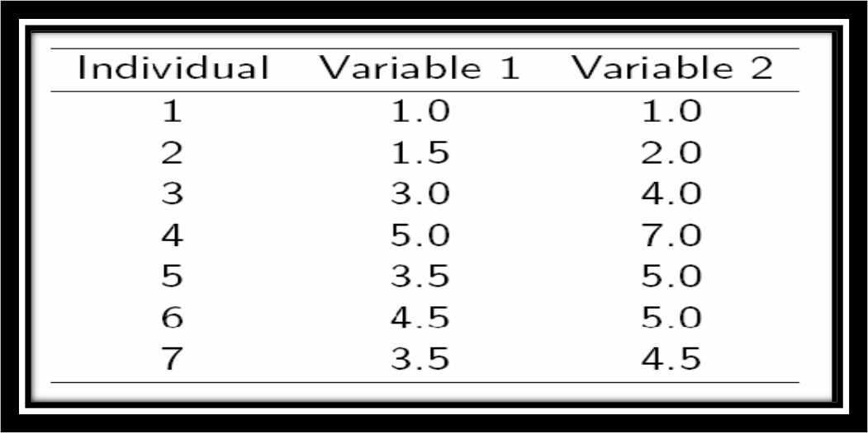
Q1. Implement K-Medoids Algorithm on the data given in Figure 1.
The value of k is 2. (20)
Figure 1

Slide 11

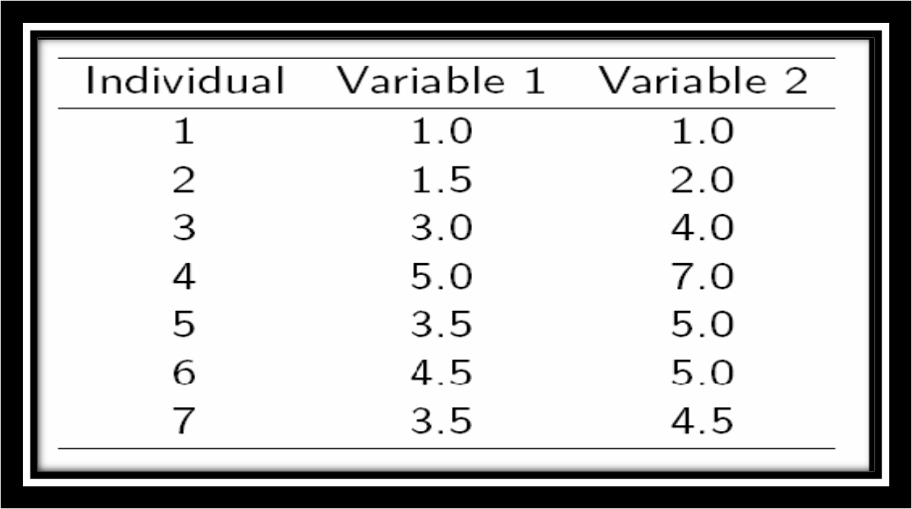
Class Activity
Q1. Implement k-means algorithm on the data given in Figure 1. The value of k is 3. Use Euclidean distance as the distance measure. (20)
Figure 1

